Slide 1
Planning and Decision-Making for Grid Facing Investments
Electric Grid Modernization Working Group Grid Facing Subcommittee
January 14, 2013

Slide 2
Agenda
Goals and Objectives
Planning Approach
Load Related Investments
Non-Load Related Investments
Conclusions

Slide 3
Goals and Objectives
Smart Grid
Reliable
Economic
Secure
Environmentally Friendly
Efficient
Safe
* U.S. National Energy Technology Laboratory

Slide 4
Planning Approach
Transmission
Distribution
System

Slide 5
Distribution Planning Approach
Identify Concerns
Evaluate
Options
Cost
Benefit
Analysis
Option
A
Option
B
Option
C
System
Modeling
Recommendation

Slide 6
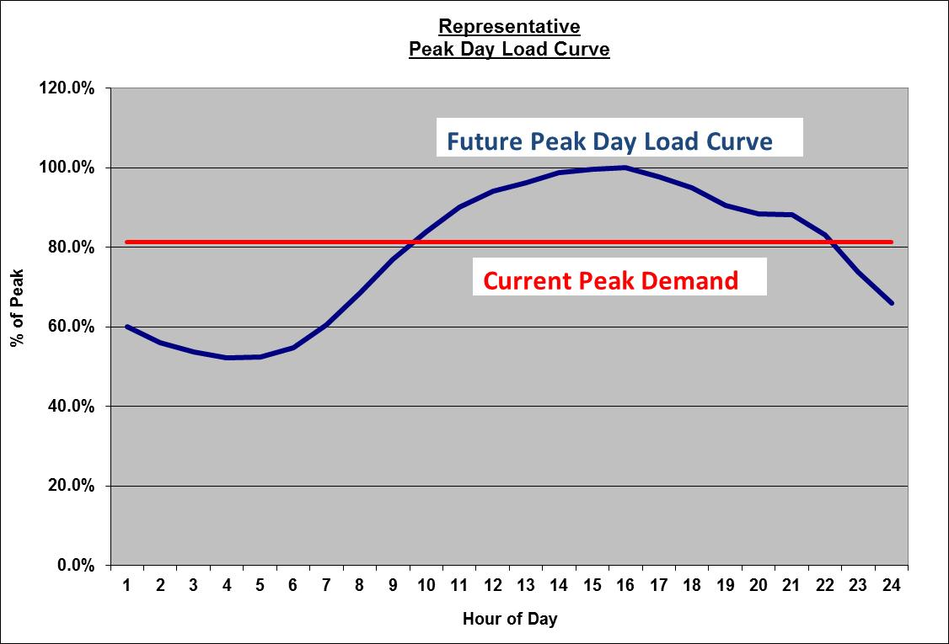
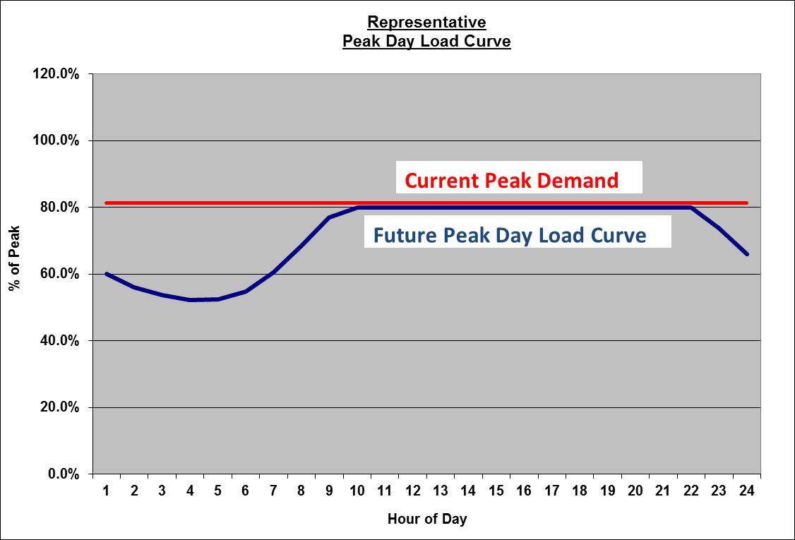
Load Related Investments
Unitil system demand driven by AC
Declining load factor – driving investment
System constructed to meet the peak demand on the peak hour
Unitil has considered a zero demand growth approach to planning
Non-traditional options evaluated to offset demand growth
Reduction in demand growth reduces the need for traditional improvements

Slide 7
Non-Traditional Options Evaluated
Residential Installation
Solar
Commercial Installation
Natural Gas Cooling
Thermal Storage
Utility
TOU Smart Grid Pilot
Solar
Wind
Natural Gas and Landfill Gas Generation
Thermal Storage
Small Wind
Solar
Natural Gas Generation
Conservation Voltage Reduction

Slide 8
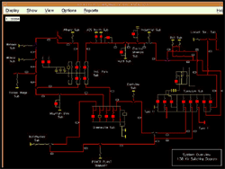
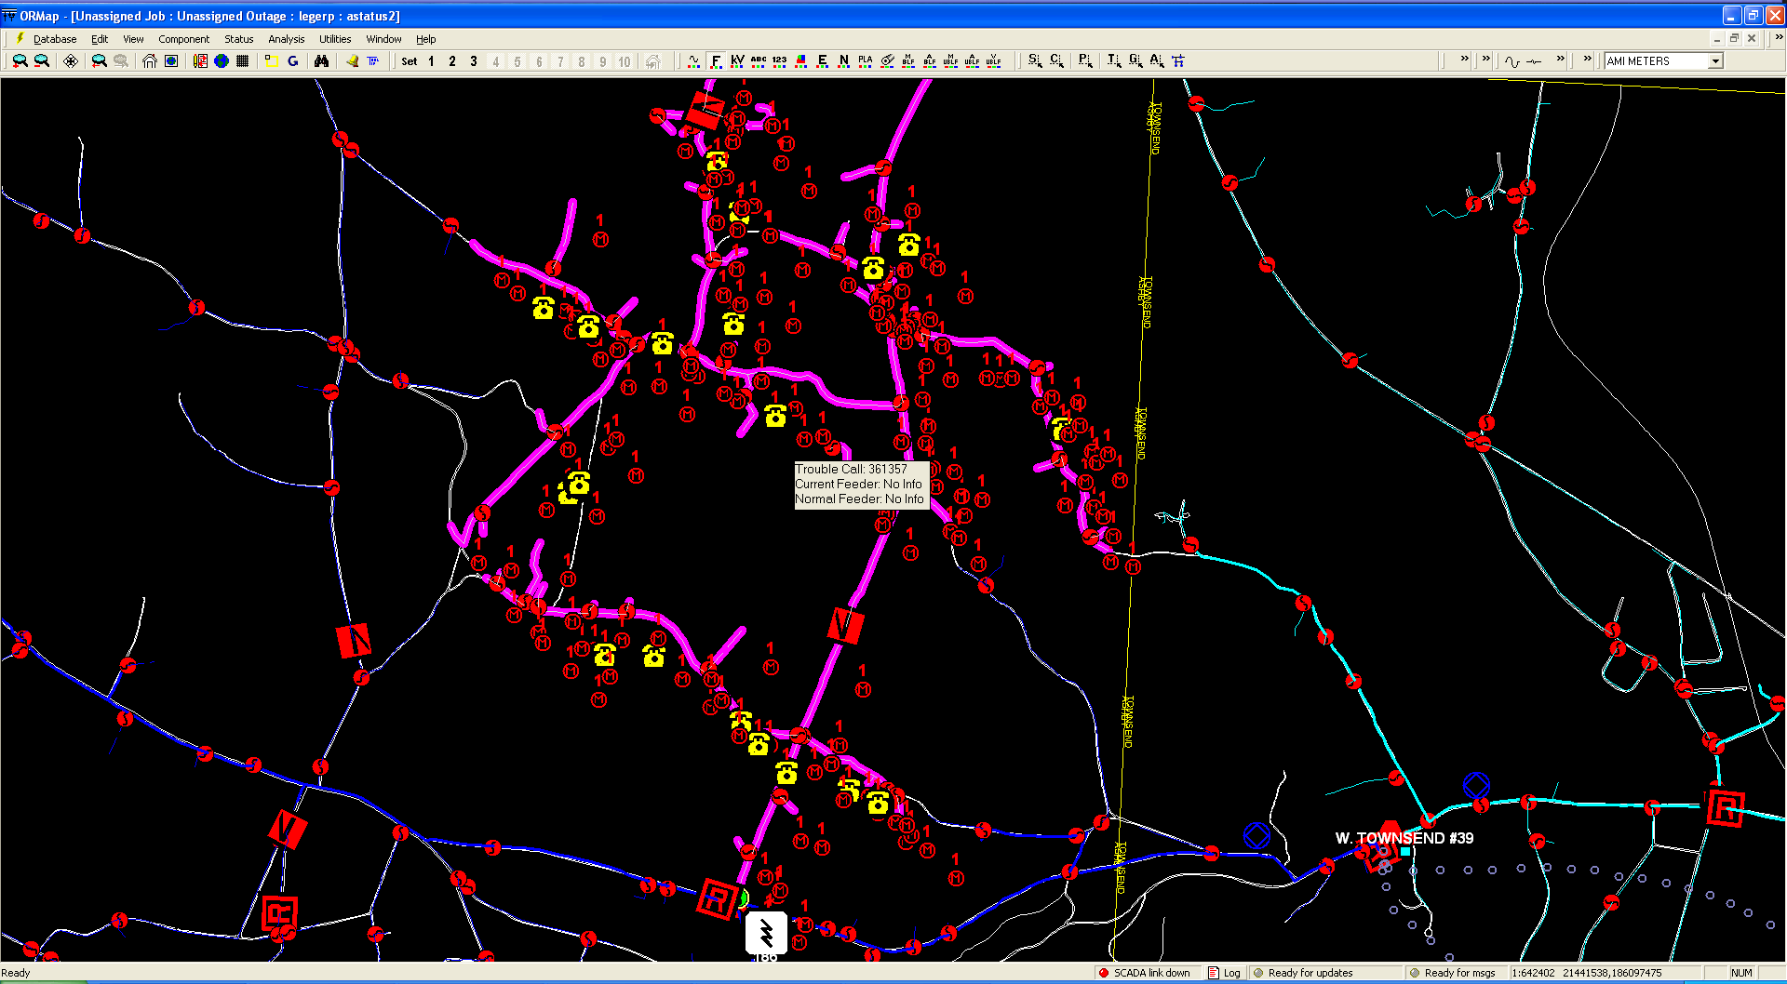
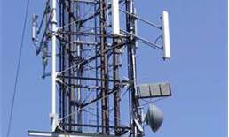
Non-Load Related Options
Cost Effective Improved Reliability
Distribution SCADA
AMI
OMS and GIS
Communication Architecture
Distribution Automation Schemes
Enhanced Tree Trimming

Slide 9
Conclusion
Planning is a complex process based upon Engineering best practices
system location, size, shape, type of customers, load characteristics, etc.
one size fits all will not work
Utilities are responsible for the electric system – not the customers
System is designed to meet the requirements (load, reliability, customer interconnections, etc)
Need solutions that are reliable and available
Rate making is based upon projects which benefit “the greater good” instead of those who benefit should pay
Challenging to evaluate non-traditional options – i.e. Who pays, who owns, who operates, who gets the benefit, who gets the recovery
Pilots are an effective means to address these challenges

Slide 10
Questions?
Kevin Sprague
Director of Engineering
Unitil
sprague@unitil.com

